Slide 1


SECURE SOFTWARE DEVELOPMENT (SSD)
Diploma in CSF
Academic Year (AY) 22/23 – Semester 3 (April `22)
Week 4
Secure software requirements – Part 2
Last Updated: 10/04/2022

Slide 2
Contents
Gather Software Security Requirements
Mission 4.1 sBooks Pte Ltd Case Study
Mission 4.2 Razor Pages Security I

Slide 3
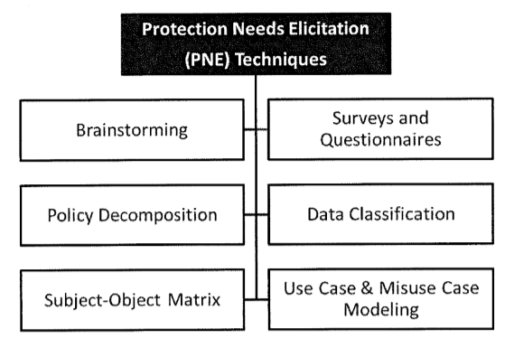
How to gather software security requirements?
Read Gathering Software Security Requirement

Slide 4
Brainstorming
Quickest but unstructured method to security requirement gathering
Primarily used to determine preliminary security requirement
Shortcoming exists in that security requirement may not relate to business context, people may not contribute their ideas
Therefore, at times, brainstorming can be subjective

Slide 5
Surveys and Questionnaires
An effective mean to collect functional and assurance requirements.
As per any surveys, quality of questions asked determines effectiveness of survey.
Explicit as well as open ended questions should be part of the questionnaire.
Open ended questions can yield security related information which may be missed if the question is too specific

Slide 6
Examples: Surveys (Questionnaires and Interviews)
What kind of data will be processed, transmitted or stored by the software?
Is the data highly sensitive or confidential in nature?
Will the software handle personally identifiable information or privacy related information?
Who are all the users who will be allowed to make alterations and will they need to be audited and monitored?
What is the maximum tolerable downtime for the software?
How quickly should the software be able to recover and restore to normal operations when disrupted?
Is there a need for single sign-on authentication?
What are the roles of users that need to be established and what privileges and rights (such as create, read, update or delete) will each role have?

Slide 7
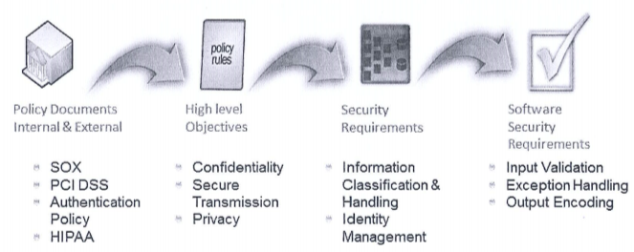
Policy Decomposition
Generally, sources of security requirement can be from internal organizational policy and/or external regulatory authority.
Policies contain high level mandate that needs to be decomposed to filter off the security requirement.

Slide 8
Data Classification
Data classification is the conscious effort to assign labels (a level of sensitivity) to information (data) assets.
It is based on potential impact to confidentiality, integrity and availability (CIA) upon disclosure, alteration or destruction.
One of the main objectives of data classification is to lower cost of data protection and maximises the return on investment when data is protected.

Slide 9
Data Classification: Labeling
Data classification is the conscious effort to assign labels (a level of sensitivity) to information (data) assets, based on potential impact to confidentiality, integrity and availability (CIA), upon disclosure, alteration or destruction.

Slide 10
Data Classification: Data Ownership
Decisions to classify data, who has access and what level of access, etc. are decisions to be made by the business owner.
The business/data owner has the responsibility for the following:
Ensure that information assets are appropriately classified.
Validate that security controls are implemented as needed by reviewing the classification periodically.
Define authorized list of users and access criteria based on information classification. This supports the Separation of Duties principle of secure design.
Ensure appropriate backup and recovery mechanisms are in place.
Delegate as needed the classification responsibility, access approval authority, backup and recovery duties to a data custodian.

Slide 11
Subject-Object Matrix
Subject-Object matrix is used to identify allowable actions between subjects (roles) and objects (components) based on use cases.
A subject-object matrix is a two-dimensional representation of roles and components.
By inversing the allowable actions captured in subject-object matrix, one can determine existence of threats, which in turn can be used to determine security requirements.

Slide 12
Subject-Object Matrix

Slide 13
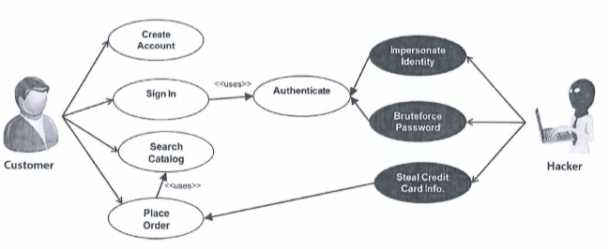
Use Case & Misuse Case Modelling
Use case modelling is a mechanism by which software functionality and security requirements can be determined.
From use cases, misuse cases can be developed.
Misuse cases/Abuse cases can help identify security requirement by modelling negative scenarios (threats).

Slide 14
Misuse Case Modeling
Misuse cases, also known as abuse cases help identify security requirements by modeling negative scenarios.
A negative scenario is an unintended behavior of the system, one that the system owner does not want to occur within the context of the use case.
Misuse cases provide insight into the threats that can occur against the system or software.
Misuse case modeling is similar to the use case modeling, except that in misuse case modeling, mis-actors and unintended scenarios or behavior are modeled.
Misuse cases may be intentional or accidental.

Slide 15
Open-Ended Question
Qn 1: It was mentioned that life won’t be back as we were used to, for a sizeable period of time, once circuit breaker period is over due to the Covid-19 situation.
In your own words, explain how would that impact security requirement gatherings?
Cite an example of one PNE (refer to slide 3) that will be affected.
Attempt the open-ended question above.
Submit your answers in Teams group.
SSD-AY2223-xxx-Pxx → Week 4
Use “Conversations” tab under “SSD-AY2223-xxx-Pxx → Week 4” to discuss within your class group.

Slide 16
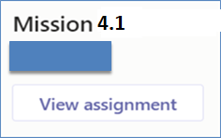
Mission 4.1: sBooks Pte Ltd Case Study
Read the attached case study – sBooks Pte Ltd.
sBooksPteLtd-CaseStudy.pdf
Answer the questions in the case study.
Sample answer (Guide) → sBooksPteLtd-CaseStudy-ExpectedAnswerGuide2.pdf
Submit Mission 4.1 in Brightspace.
Deadline: End of Week 5 Penalty for late submission
If you got any issues regarding Mission 4.1
Use “Conversations” tab under “SSD-AY2223-xxx-Pxx → Week 4” to discuss within your class group.
Tutors would also monitor these “Conversations”

Slide 17
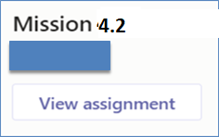
Mission 4.2: Razor Pages Security I
Attempt the Razor Pages Security I practical
Download Razor Pages Security I practical guide from Brightspace.
Submit detailed screenshots of your completed practical page in Brightspace.
The screenshots must show the browser’s “Address Bar” to verify the application is running in your laptop.
Deadline: End of Week 5
Penalty for late submission
If you got any issues regarding Mission 4.2
Use “Conversations” tab under “SSD-AY2223-xxx-Pxx → Week 4” to discuss within your class group.
Tutors would also monitor these “Conversations”.

